Slide 1
Exploring Documents as Data
Nakshatra Yalagach, Sara Shallenberger,
Data Science for the Public Good (DSPG) Interns
Joanna Schroeder and Joel Thurston
DSPG Team Leads, Social and Decision Analytics Division
Andrew Slaughter, Sponsor
US Army Research Institute for the Behavioral and Social Sciences
30 June 2023

Slide 2
The research described herein was sponsored by the U.S. Army Research Institute for the Behavioral and Social Sciences, Department of the Army (Cooperative Agreement No. W911NF-20-20-027). The views expressed in this presentation are those of the authors and do not reflect the official policy or position of the Department of the Army, DOD, or the U.S. Government.
Notes:
We are embracing new ways to repurpose these existing Army data to measure the social characteristics of individual Soldiers and units.
This research will provide statistical models that forecast and visualize individual and unit performance.

Slide 3
Goals
Explore methods to extract assignments from documents
Modeling Textual data
Analyze soldier career progression and their connections to psychosocial traits
Contribute our knowledge of Large Language models (LLM) to open-source repositories.
Notes:
We are embracing new ways to repurpose these existing Army data to measure the social characteristics of individual Soldiers and units.
This research will provide statistical models that forecast and visualize individual and unit performance.

Slide 4
Dataset
Documents from the Smartbook for DA Pam 600-3 Officer Professional Development and Career Management
14 Branches and Functional Areas (FA)
11 - Operations (e.g., Armor, Field Artillery, Infantry)
3 - Information Dominance (i.e., Cyber, Electronic Warfare, Information Operations)
Attributes extracted:
Assignments (e.g., Platoon Leader, Battalion Commander)
Type of Assignment
Key Developmental
Developmental/Broadening
Rank (e.g., Lieutenant, Captain, Major)
Notes:
Army data sources are administrative records (e.g., demographics, training history, accessions, and attrition data)
Non-DOD data sources – developed process with AAG-RFL for ingestion and curation and making available to all
users

Slide 5
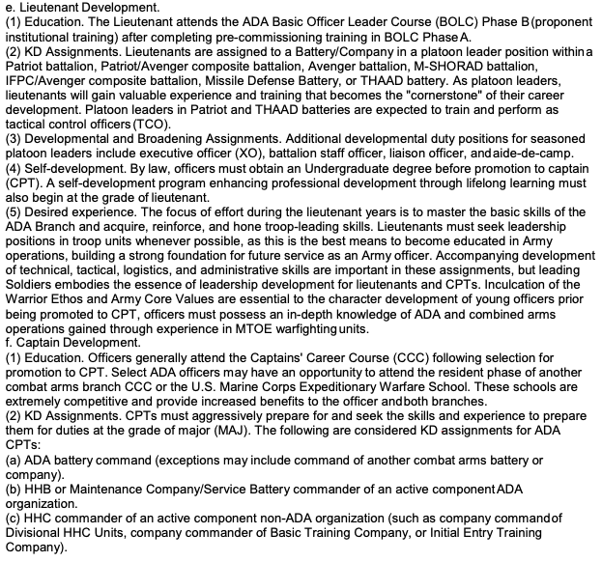

















Sample Document A:
Air Defense
Artillery
Type
Assignments
Ranks
Type
Assignments

Slide 6
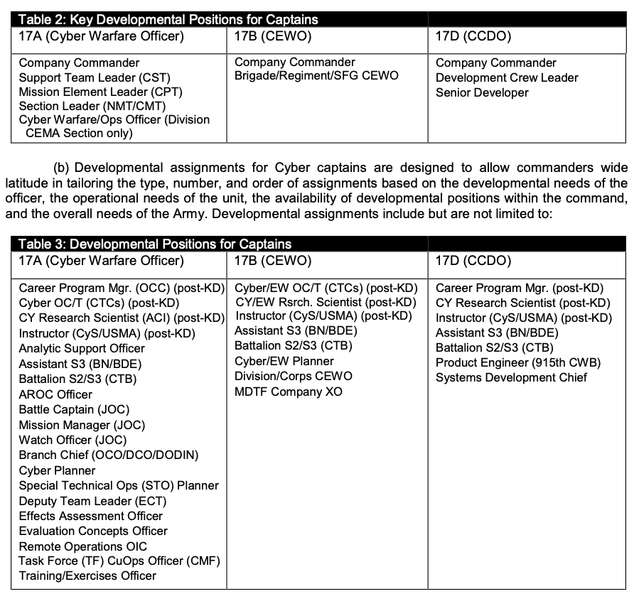










Sample Document B: Cyber Branch
Assignments
Type
Ranks
Assignments

Slide 7
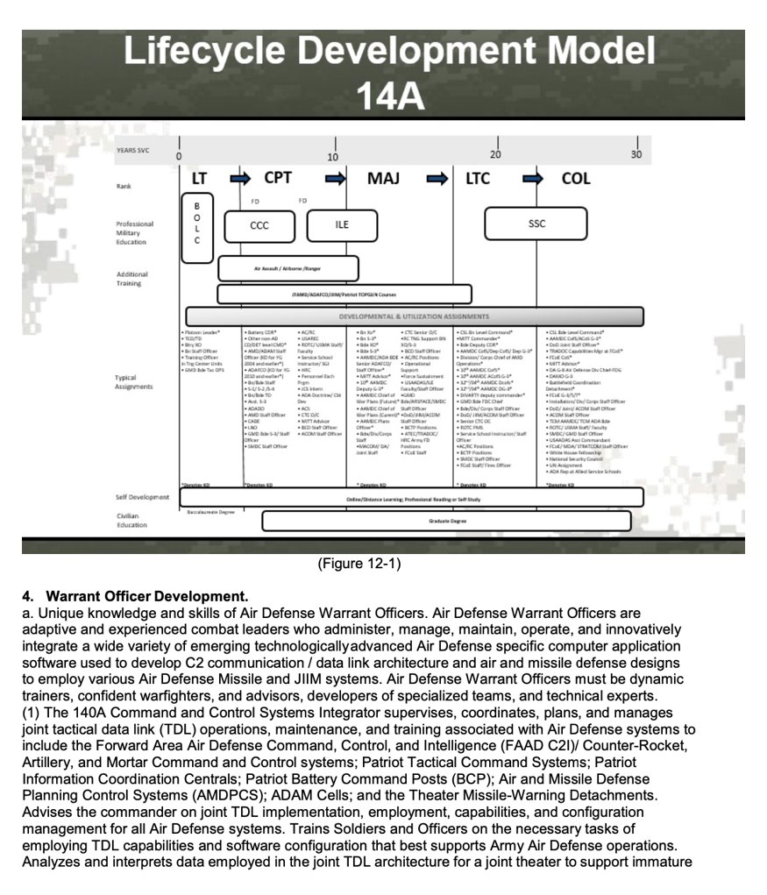
Ranks
Sample Document A: Air Defense Artillery
Type
Assignments

Slide 8
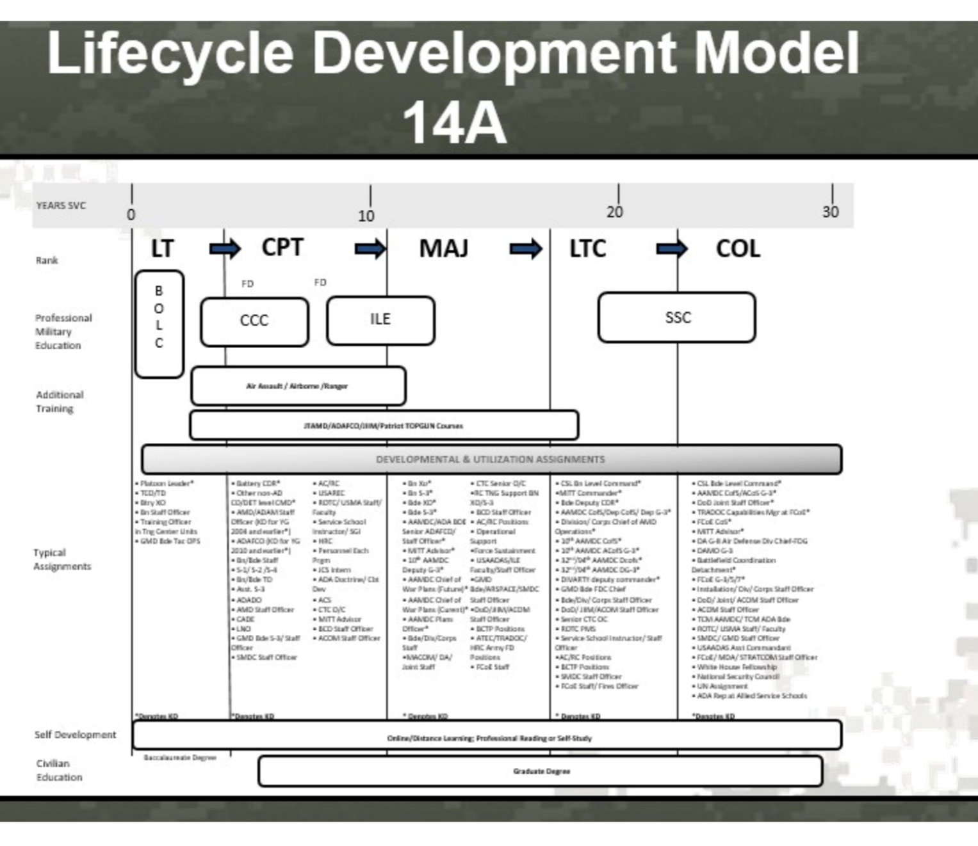
Before Upscaling
Notes:
Work on this after talking to Kathryn

Slide 9
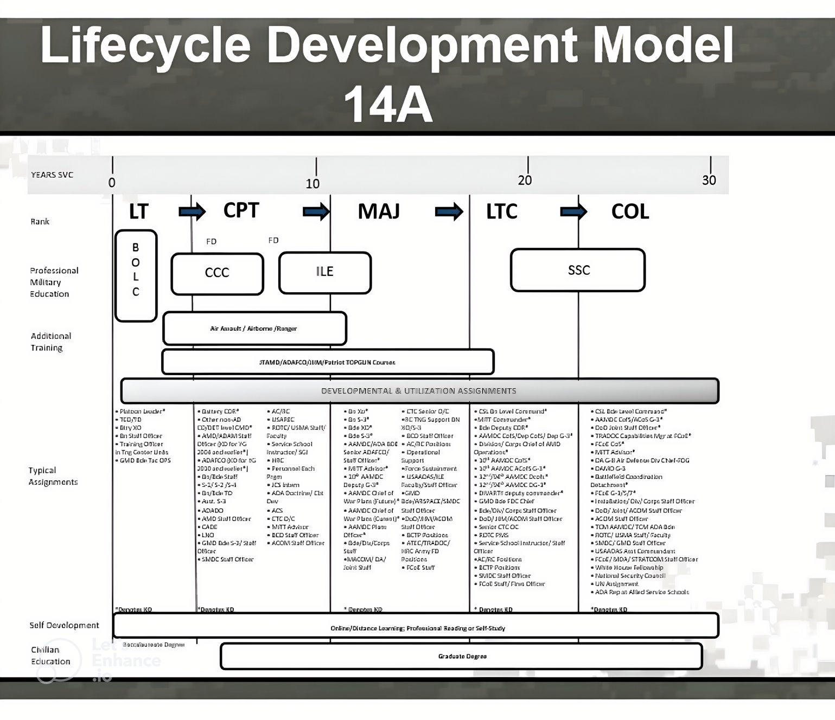
After Upscaling
Notes:
Work on this after talking to Kathryn

Slide 10
Method 1: Image Upscaler
Benefits
Enhanced resolution
Reduced noise
Time efficient
Drawbacks
Distorted results
Illegible
Partial Improvement

Slide 11
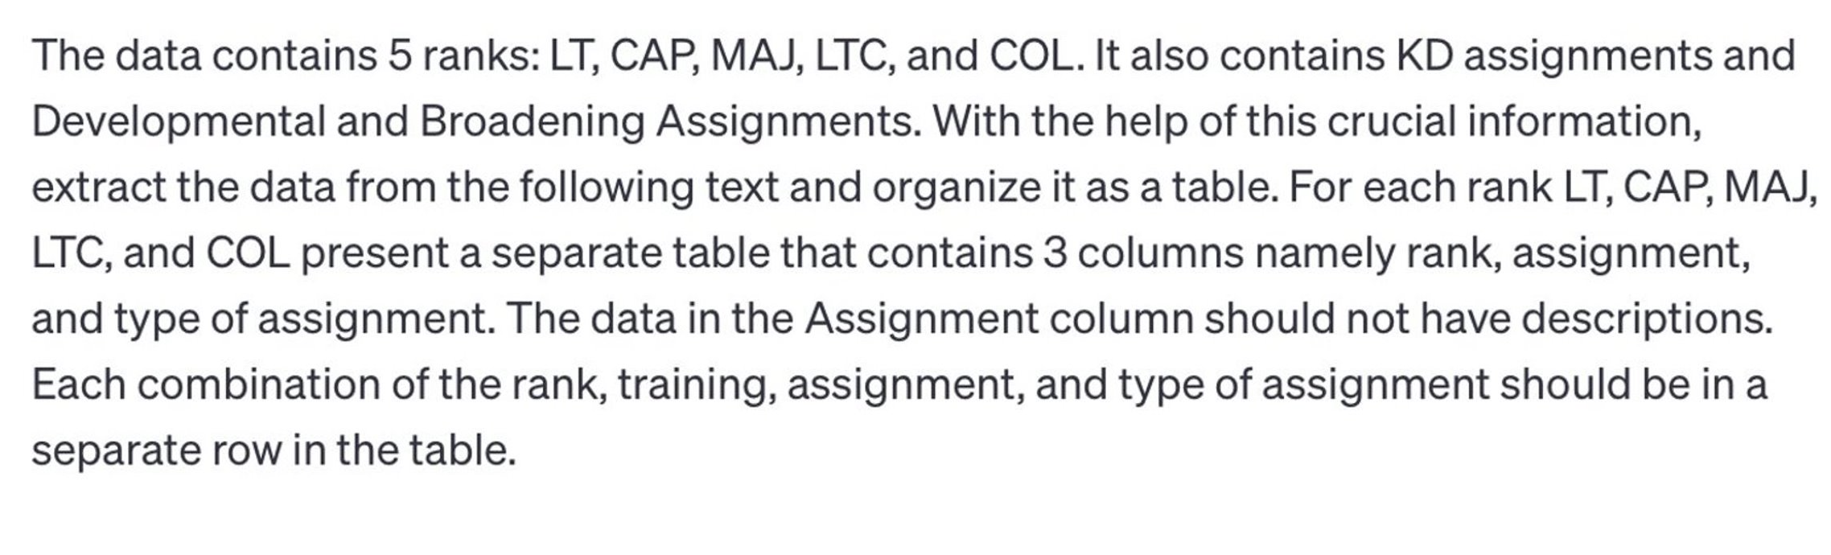



ChatGPT Prompt
Notes:
Work on this after talking to Kathryn

Slide 12
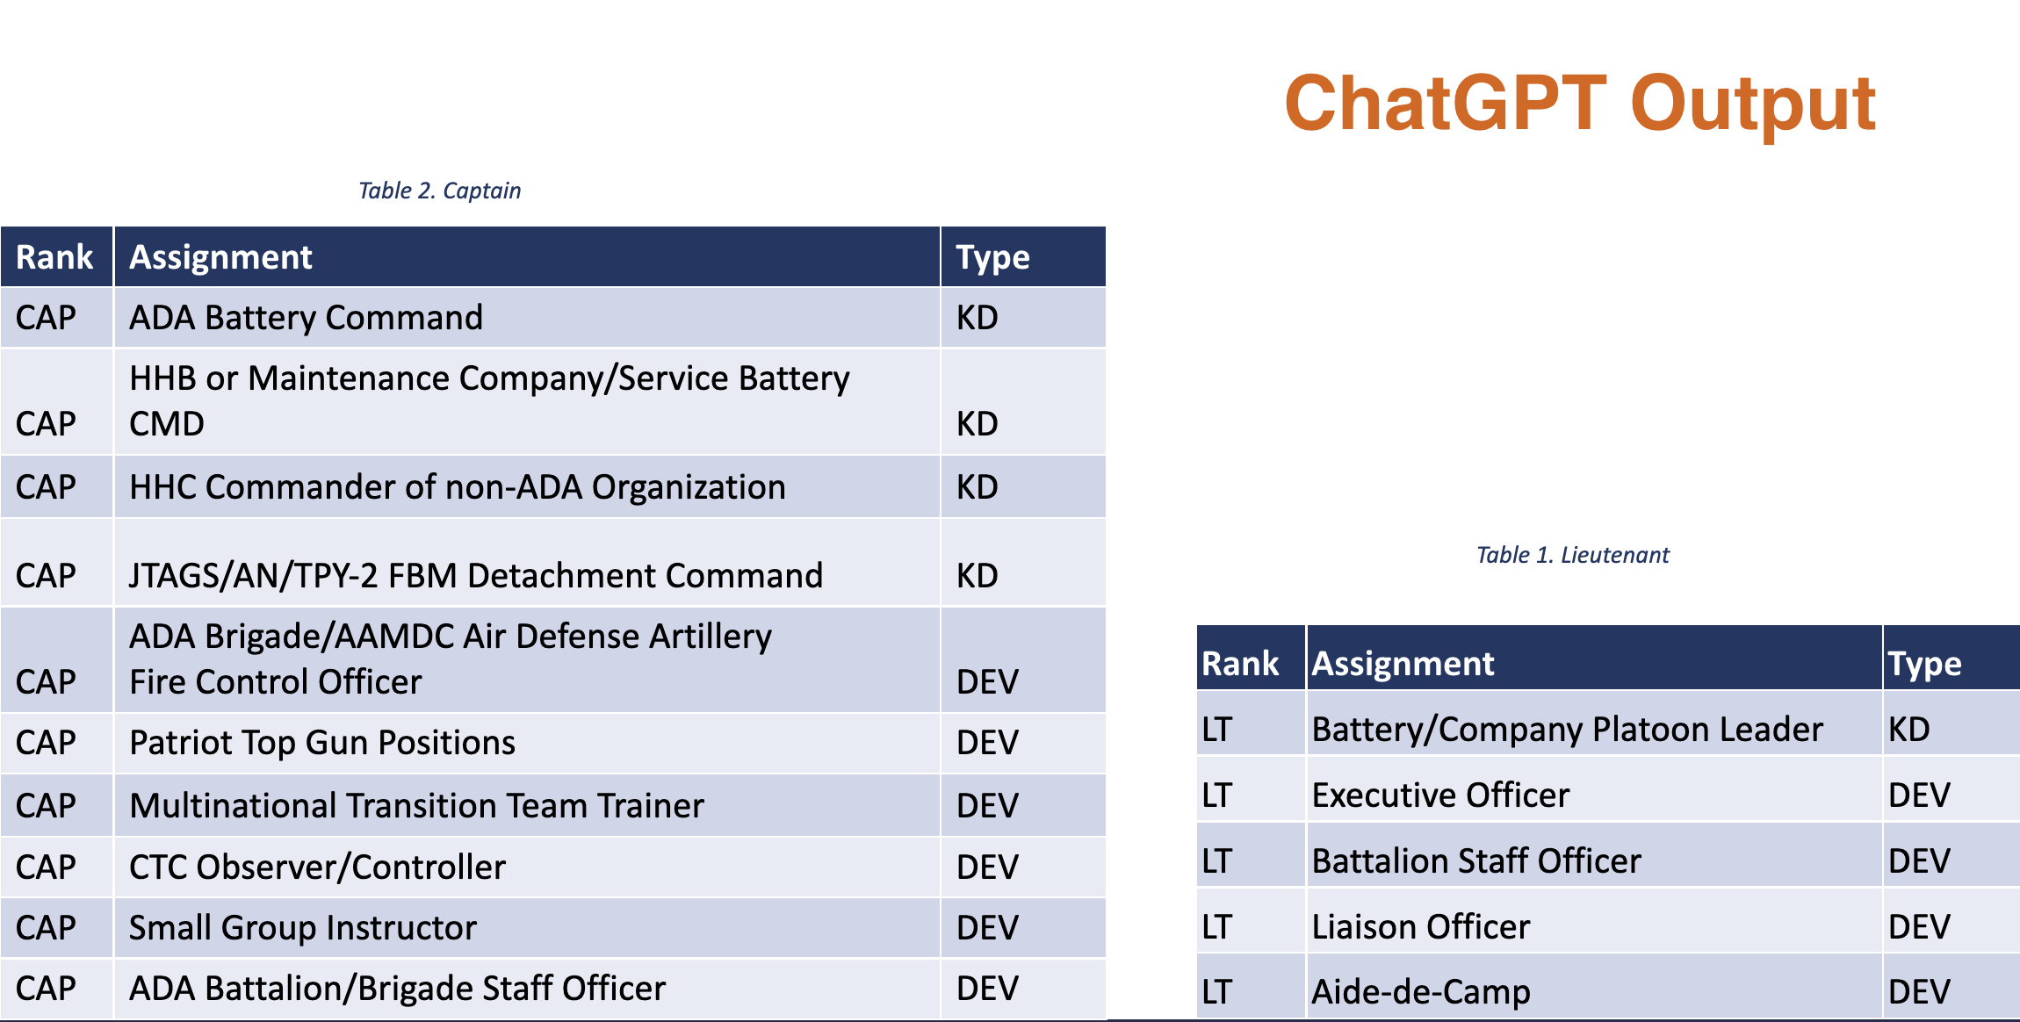
ChatGPT Output
Notes:
Work on this after talking to Kathryn

Slide 13
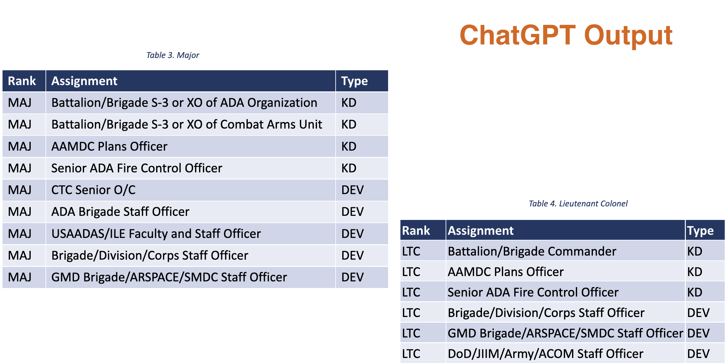
ChatGPT Output
Notes:
Work on this after talking to Kathryn

Slide 14
Method 2: ChatGPT Solution
Benefits
Easily and quickly implemented
Applicable across all documents
Re-usable prompts
Equal effectiveness at data extraction across multiple test documents
Drawbacks
Not reproducible
Sensitive to individual user input
Can generate different responses given the same prompt
Less precise extraction of assignments
Notes:
Work on this after talking to Kathryn

Slide 15
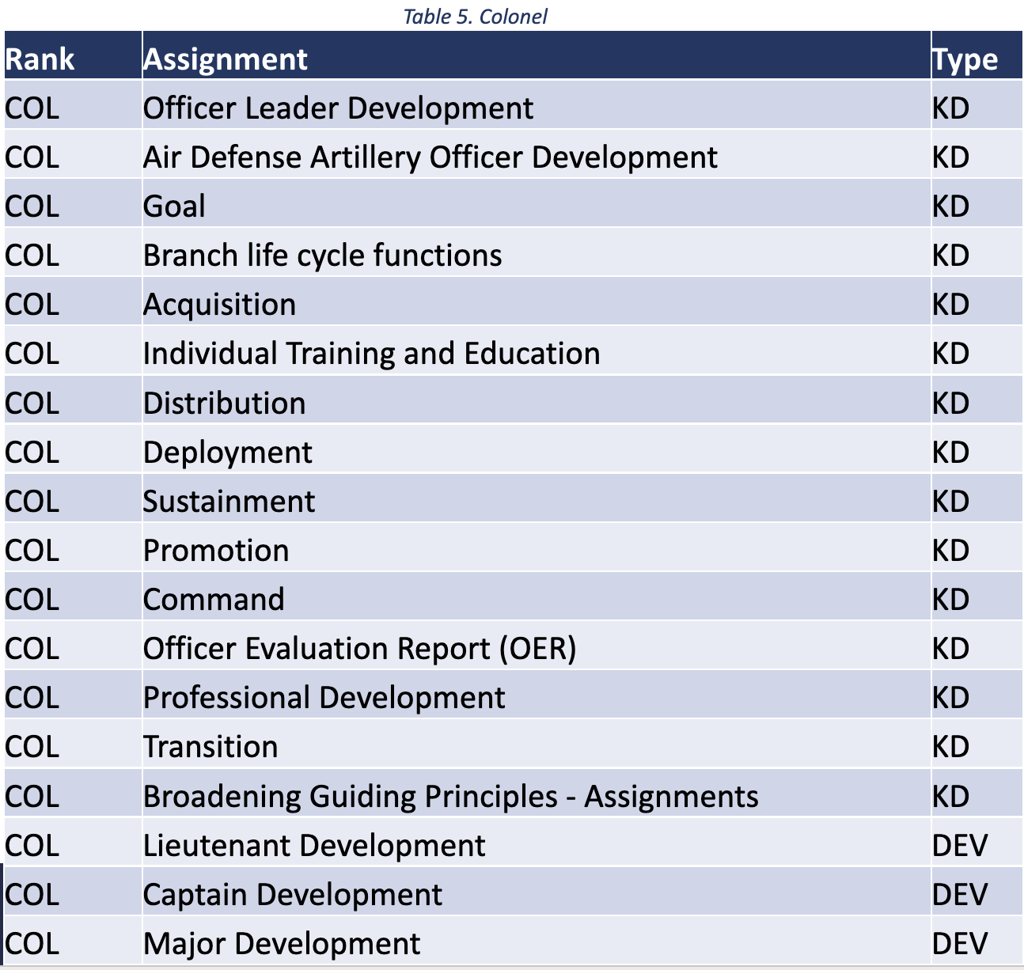
ChatGPT Output
Notes:
Work on this after talking to Kathryn

Slide 16
Regex
Adopted menthod

Slide 17
Method 3: Regex Solution
Benefits
Precise
Captures the most unique assignments
Supervised data formatting
Output format (data cleaning and splitting on slashes, commas, etc.) controlled by the scientist
Drawbacks
Time intensive
Unique regex and extraction process for each document
Poorly suited to large sets of documents
Military Occupational Specialty (ex. Infantry) | Rank (ex. Lieutenant) | Assignment (ex. Executive Officer) | Type (ex. Key Developmental)

Slide 18
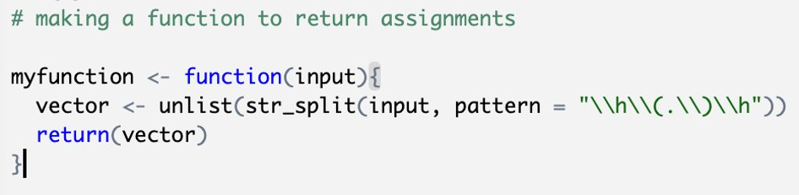
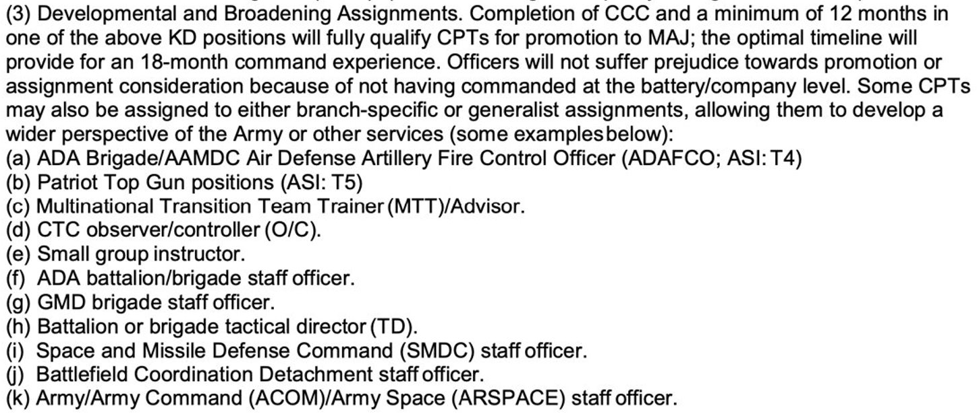
Regex: Sample Input
Sample of a function used to split up assignments:
Function splits up the following paragraph
by its parenthetical delimiters, ex. (a).

Slide 19
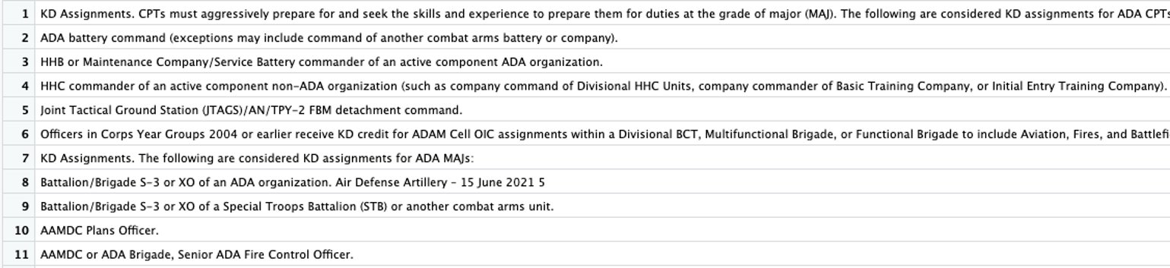
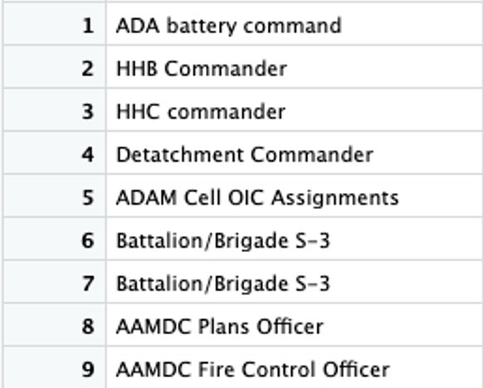
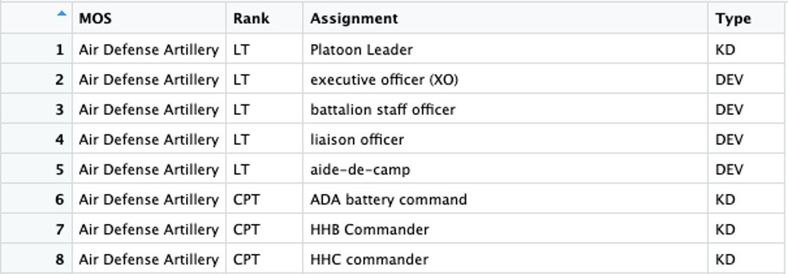
Continued: Regex Process
After function is applied, we get output that looks like this:
After function is applied, we get output that looks like this:

Slide 20
Regex: Exploratory Data Analysis
Assignment Type​ | Number of Unique Assignments​
Key Developmental​ | 212​
Developmental/Broadening​ | 575​
Table 2. Army branches and number of unique assignments in each branch.
Branch​ | Number of Unique Assignments​
Military Police​ | 41​
Chemical​ | 33​
Cyber​ | 28​
Civil Affairs​ | 26​
Air Defense Artillery​ | 22​
Engineers​ | 22​
Armor​ | 19​
Field Artillery​ | 19​
Aviation​ | 12​
Information Operations​ | 11​
Special Forces​ | 11​
Psychological Operations​ | 10​
Electronic Warfare​ | 9​
Infantry​ | 4​
Table 1. Army branch assignment types and number of unique assignments for each type.
Rank​ | Number of Unique Assignments​
Lieutenant​ | 22​
Captain​ | 33​
Major​ | 71​
Lieutenant Colonel​ | 50​
Colonel​ | 63​
Table 3. Army ranks and count of unique assignments for each rank.

Slide 21
Next Steps
Evaluate
Evaluate the results with manually coded ground truth document
Perform
Perform further analysis using rank and Military Occupation Specialty (MOS)
Familiarize
Familiarize with BERT
Analyze
Analyze the progression of soldier careers assignment
Publish
Publish data in DOD/Army repositories for easy internal analyst access and on web

